Slide 1

IFT222
Computer Architecture and Organization
Department of Computer and Information Sciences
INSTRUCTION SET ARCHITECTURE

Slide 2
Learning Outcomes
By the end of this lecture, students should be able to:
  Define Instruction Set Architecture (ISA)
  Explain the components and features of ISA
  Identify different instruction types and formats
  Differentiate between addressing modes
  Compare RISC and CISC architectures
  Analyze instruction execution with examples
  Apply ISA concepts to solve practical problems

Slide 3
Introduction
Instruction Set Architecture (ISA) is one of the most fundamental concepts in Computer Architecture and Organization.
It defines the interface between hardware and software, acting as a bridge that allows software programs to communicate with the processor.
In simple terms, ISA specifies:
  What operations a processor can perform (instruction set)
  How instructions are represented (instruction format)
  How data is accessed and manipulated (addressing modes)

Slide 4
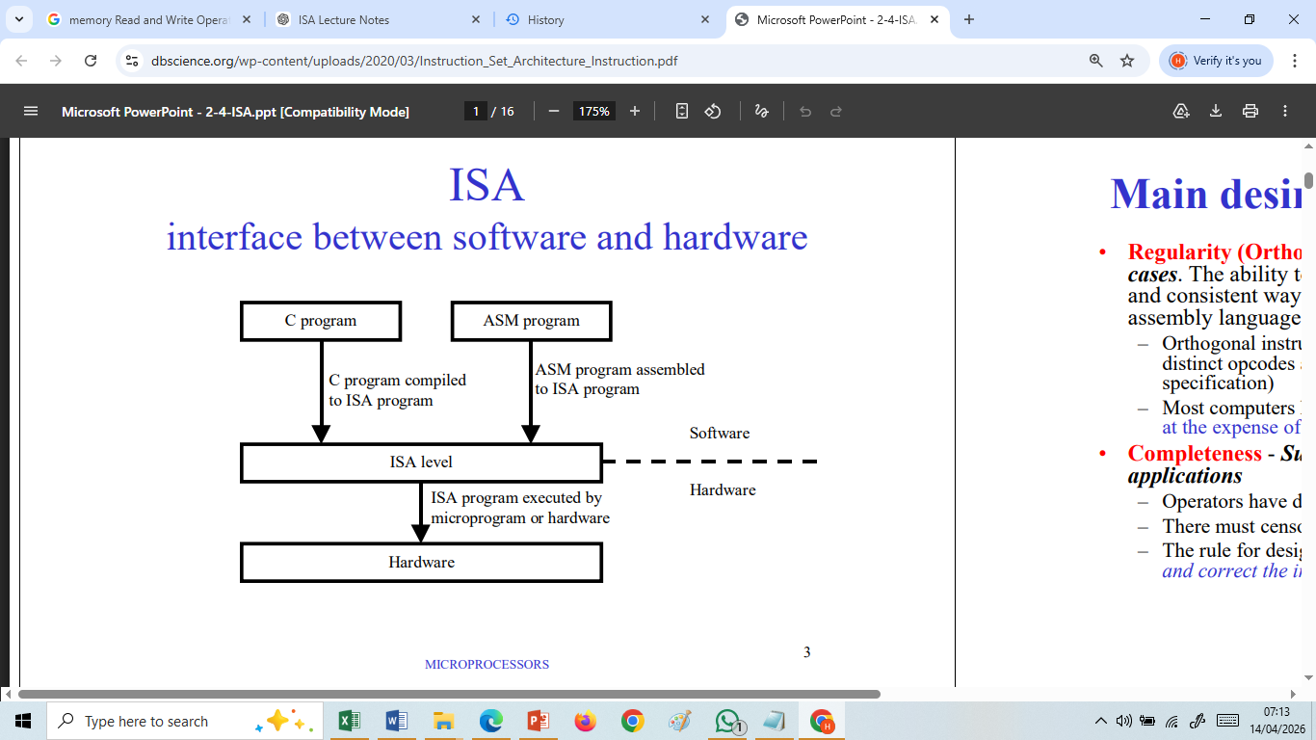

Slide 5
Key Components of the ISA
a) Instruction Set
The complete set of instructions a processor can execute.
Examples:
  • Arithmetic: ADD, SUB
  • Logical: AND, OR
  • Control: JUMP, CALL
  • Data Transfer: LOAD, STORE

Slide 6
Key Components of the ISA
b) Registers
Small, fast storage locations inside the CPU.
Types:
  • General Purpose Registers (GPR)
  • Special Registers (PC , IR, MAR, MDR)
c) Data Types
Defines the types of data supported:
• Integer, Floating point, Character , Boolean

Slide 7
Key Components of the ISA
d) Addressing Modes
Methods used to access operands at runtime.
Common types:
  • Immediate
  • Direct
  • Indirect
  • Register
  • Indexed

Slide 8
Key Components of the ISA
e) Instruction Format
Structure of an instruction: opcode and operand, addressing mode
• Opcode (operation)
• Operand(s)
Example:
ADD R1, R2 (add R1 and R2 and store result in R1)
Opcode = ADD
Operands = R1 and R2

Slide 9
Types of Instructions
Within Instruction Set Architecture (ISA), types of instructions define the various operations a processor can perform on data.
These instructions determine how a program:
  Moves data
  Performs computations
  Makes decisions
  Interacts with memory and I/O devices

Slide 10
Types of Instructions
Each instruction type is designed to handle a specific category of tasks, and together they form the complete functional capability of a CPU.
  Understanding instruction types is essential for:
  Writing efficient assembly programs
  Designing compilers
  Optimizing system performance

Slide 11
Types of Instructions - Load/Store Instructions
Load/store operations are those which move data between a register in the processor and a memory location (or another register).
They are often collectively referred to as data movement instructions.
The two terms load and store are often confused and should be carefully distinguished from each other.
The next slide presents a picture of the load operation(instruction)

Slide 12
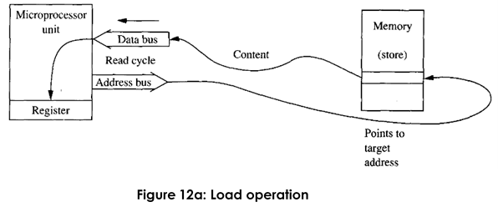
Load Operation

Slide 13
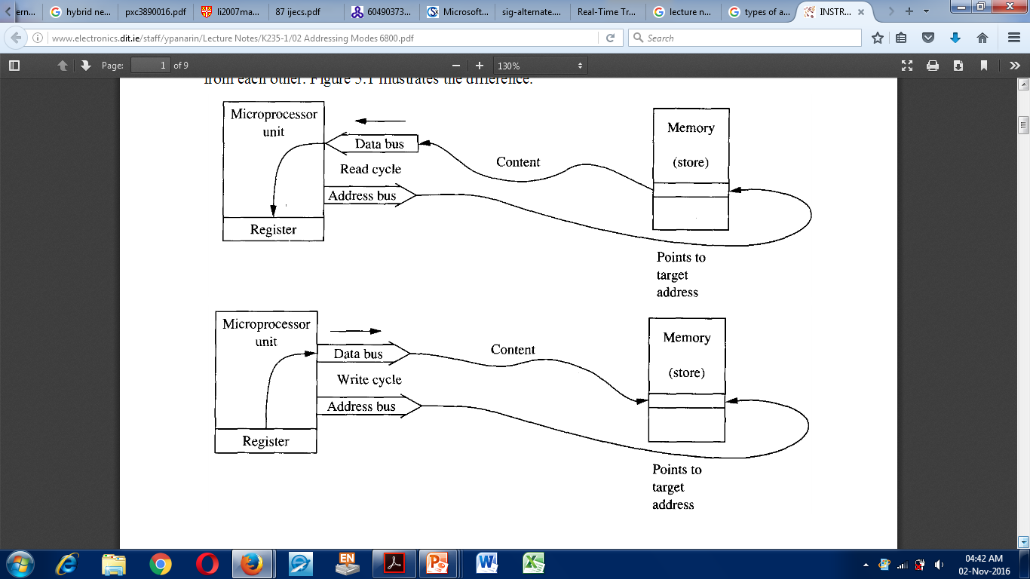
Store Operation

Slide 14
Types of Instructions - Load/Store Instructions
One of the universal characteristics of instruction execution is that the source does not get changed, only the destination.
Thus, in a load operation the processor copies data into a register, and in a store operation the processor copies data from a register into a memory location.
Examples of load/store instructions in the MC68009 processor are LDA, STA, LDB, STB, LDD, STD, and so forth.

Slide 15
Types of Instructions - Load/Store Instructions
Examples of load/store instructions in the MC68000 processor are
MOVE (for either direction of data movement),
MOVEM (for moving the content of several registers into or out of memory with a single instruction), and
EXG (for exchanging register contents).
These instructions and others like them must include information identifying the source and destination.

Slide 16
Types of Instructions - Arithmetic/Logic Instructions
Arithmetic/logic operations provide the primary data-processing capabilities of the computer.
The minimum arithmetic operations required are those of addition and subtraction. 5 – 3 = 5 + (-3) 101 + 011
All processors, implement the basic logic operations of AND, OR, and exclusive-OR on a bit-by-bit basis between two operands.
With operations requiring two operands, smaller microprocessors usually require that one of the operands must be in a destination register initially, while the other may be in another register or in memory.

Slide 17
Types of Instructions - Arithmetic/Logic Instructions
Their instructions may identify at most a single operand in memory, as shown in the next slide.
They support such operations as ADDing or ANDing to processor registers as illustrated but not to memory locations.

Slide 18
Types of Instructions - Arithmetic/Logic Instructions
Some examples of two-operand arithmetic/logic instructions in the MC6809 are ADDB, SUBA, SUBD, ANDA, and EORA (exclusive-OR). Each of these requires one operand to be in an accumulator
Some two-operand arithmetic/logic instructions in the MC68000 instruction set are ADD, AND, OR, SUB, and EOR.
All of the two-operand instructions in the MC68000 must specify the source and the destination.
With a few exceptions, these may both be registers or memory locations or one of each

Slide 19
Types of Instructions - Test/Branch Instructions
Test/branch operations provide the decision-making capabilities in computer programs.
The test is often performed on the result of some prior arithmetic/logic operation.
It determines whether the result was zero or non-zero, positive or negative, or some other binary choice involving bits in the condition code register.
During the execution of a test/branch instruction, the processor examines the appropriate condition code bits to determine the result of the test.

Slide 20
Types of Instructions - Test/Branch Instructions
Depending upon the result, the processor may or may not branch to a remote location for the next instruction.
Examples of test/branch instructions are BCC (branch if carry is cleared), BEQ (branch if equal to 0), BMI (branch if minus), and BRA (branch always).

Slide 21
Instruction Formats

Slide 22
Instruction Format
An instruction is usually made up of a combination of an operation code and some way of specifying an operand, most commonly by its location or address in memory.
Instruction Format is the layout of bits in an instruction
11100011111110000001110000 = ADD R1,R2
An instruction is divided into Opcode (function), operand(s) (implicit or explicit) and addressing mode.
Instructions typically have 0,1,2 or 3 operands
There is usually more than one instruction format in an instruction set

Slide 23
General Structure of an Instruction
The format of an instruction is usually depicted in a rectangular box symbolizing the bits of the instruction as they appear in memory words or in a control register.
The bits of the instruction are divided into groups called fields. The most common fields found in instruction formats are:
Opcode
Mode
Address or Operand

Slide 24
General Structure of an Instruction
An operation code field that specifies the operation to be performed.
An address field that designates a memory address or a processor register.
A mode field that specifies the way the operand or the effective address is determined.

Slide 25
General Structure of an Instruction
Example 1: Simple 16-bit Instruction Format
Format : 1111111100001111
| Opcode (4 bits) | Register (4 bits) | Address (8 bits) |
Explanation
  Opcode (4 bits) → Defines operation (e.g., ADD, SUB)
  Register (4 bits) → Specifies register (e.g., R1, R2)
  Address (8 bits) → Memory location

Slide 26
General Structure of an Instruction
Binary Example
1010 0011 11001010
Breakdown
Field Bits Value Meaning
Opcode 1010 ADD Perform addition
Register 0011 R3 Use register 3
Address 11001010 202 Memory location 202
Interpretation: ADD R3, [202]

Slide 27
General Structure of an Instruction
Binary Example 2 (32 bits)
000001 00001 00010 00011 00000000000
Breakdown
Field Meaning
Opcode = 000001 ADD
R1 = 00001 Destination (R1)
R2 = 00010 Operand 1 (R2)
R3 = 00011 Operand 2 (R3)
Interpretation
ADD R1, R2, R3

Slide 28
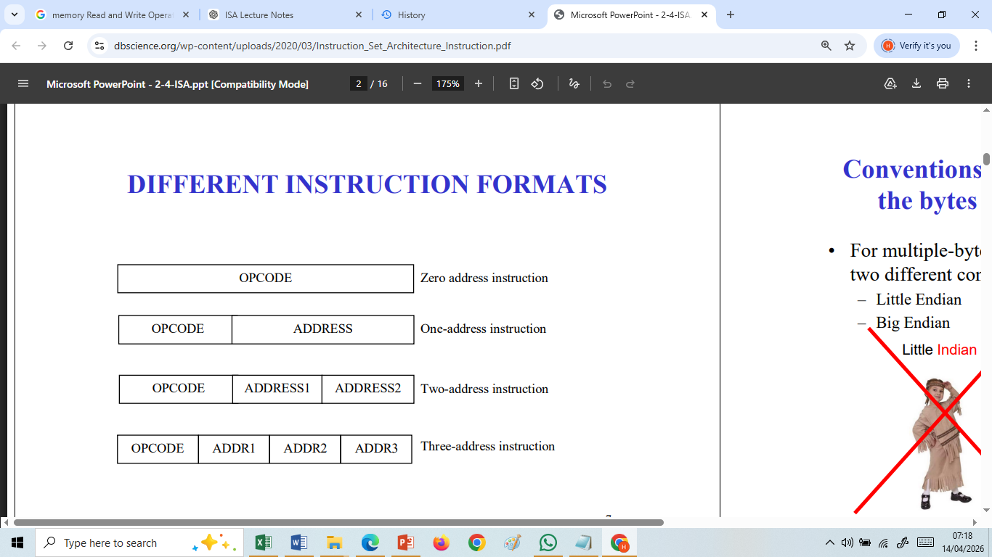

Slide 29
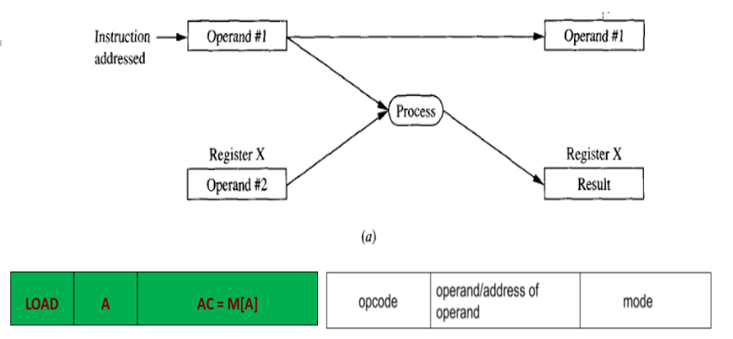
Figure: Instruction format for One Address

Slide 30
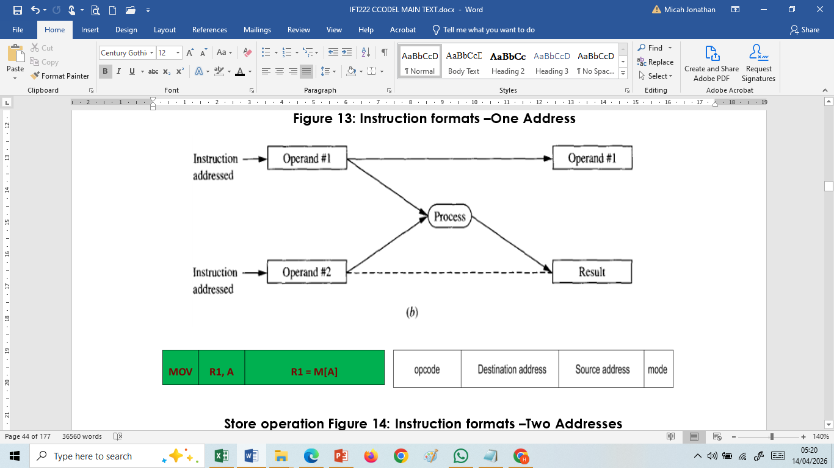
Figure: Instruction format for Two Addresses

Slide 31
Figure: Instruction format for Two Addresses

Slide 32
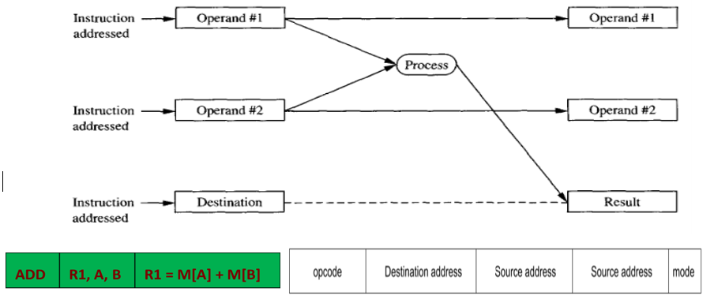
Figure: Instruction format for Three Addresses

Slide 33
Instruction Format Examples
Let’s attempt to study various instruction formats using the following program.
The program in assembly language that evaluates
X = (A + B) * (C + D)
We shall use this to understand 3,2,1, and 0 instruction formats

Slide 34
Three Address - Instruction Format
X = (A + B) * (C + D) X =A +B + C
ADD R1, A, B R1 ← M[A] + M[B] ADD R1,A,B
ADD R2, C, D R2 ← M[C] + M[D] ADD X, R1,C
MUL X, R1, R2 M[X] ← R1 * R2
It is assumed that the computer has two processor registers, R1 and R2. The symbol M[A] denotes the operand at memory address symbolized by A.
The advantage of the three-address format is that it results in short programs when evaluating arithmetic expressions.
The disadvantage is that the binary-coded instructions require too many bits to specify three addresses.

Slide 35
Two Address - Instruction Format
Two-address instructions are the most common in commercial computers. Here again each address field can specify either a processor register or a memory word. The program to evaluate X = (A + B) * (C + D) is as follows:
MOV R1, A R1 ← M[A]
ADD R1, B R1 ← R1 + M[B]
MOV R2, C R2 ← M[C]
ADD R2, D R2 ← R2 + M[D]
MOL R1, R2 R1 ← R1 * R2
MOV X, R1 M[X] ← R1

Slide 36
Two Address - Instruction Format
The MOV instruction moves or transfers the operands to and from memory and processor registers.
The first symbol listed in an instruction is assumed to be both a source and the destination where the result of the operation is transferred.

Slide 37
One Address - Instruction Format
One-address instructions use an implied accumulator (AC) register for all data manipulation.
For multiplication and division there is a need for a second register.
However, here we will neglect the second register and assume that the AC contains the result of all operations.
The program to evaluate X = (A + B) * (C + D) is

Slide 38
One Address - Instruction Format
  LOAD A AC ← M[AJ
  ADD B AC ← AC + M[B]
  STORE T M[T] ← AC
  LOAD C AC ← M[C]
  ADD D AC ← AC + M[D]
  MOL T AC ← AC*M[T]
  STORE X M[X] ← AC
All operations are done between the AC register and a memory operand. T is the address of a temporary memory location required for storing the intermediate result.

Slide 39
Zero Address - Instruction Format
A stack-organized computer does not use an address field for the instructions ADD and MUL.
The PUSH and POP instructions, however, need an address field to specify the operand that communicates with the stack.
The following program shows how X = (A + B) * (C + D) will be written for a stack organized computer. (TOS stands for top of stack).

Slide 40
Zero Address - Instruction Format
  PUSH A TOS ← A
  PUSH B TOS ← B
  ADD TOS ← (A + B)
  PUSH C TOS ← C
  PUSH D TOS ← D
  ADD TO S ← (C + D)
  MOL TOS ← (C + D)*(A + B)
  POP X M[X] ← TOS

Slide 41
Zero Address - Instruction Format
To evaluate arithmetic expressions in a stack computer, it is necessary to convert the expression into reverse Polish notation.
The name "zero-address" is given to this type of computer because of the absence of an address field in the computational instructions.

Slide 42
Addressing Modes

Slide 43
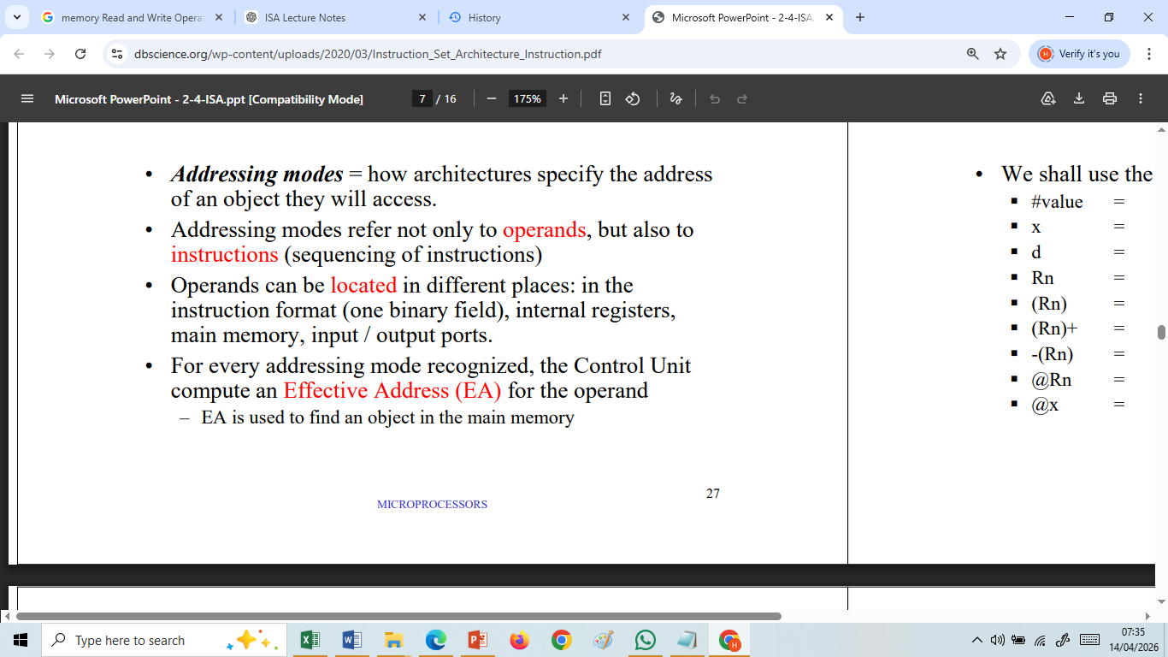
Addressing Modes

Slide 44
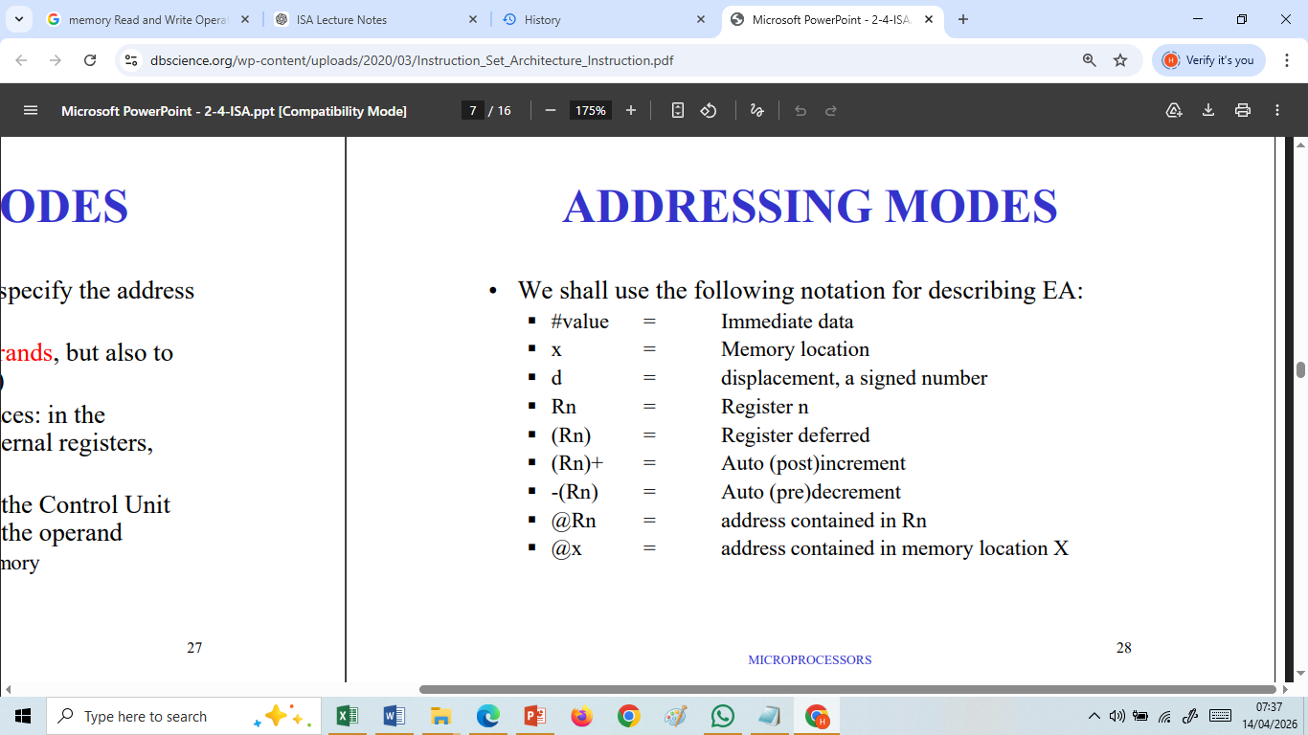
Addressing Modes

Slide 45
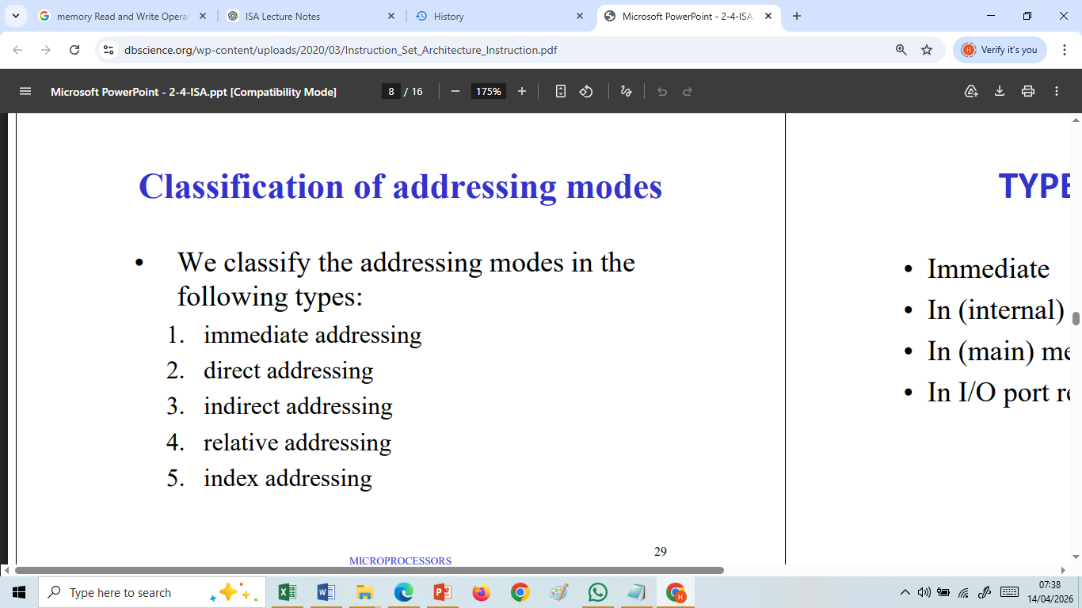
Classification of Addressing Modes

Slide 46
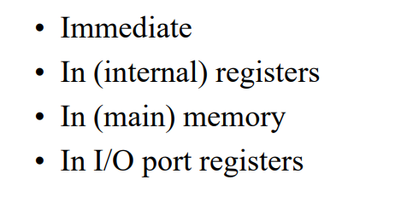
Classification of Addressing Modes

Slide 47
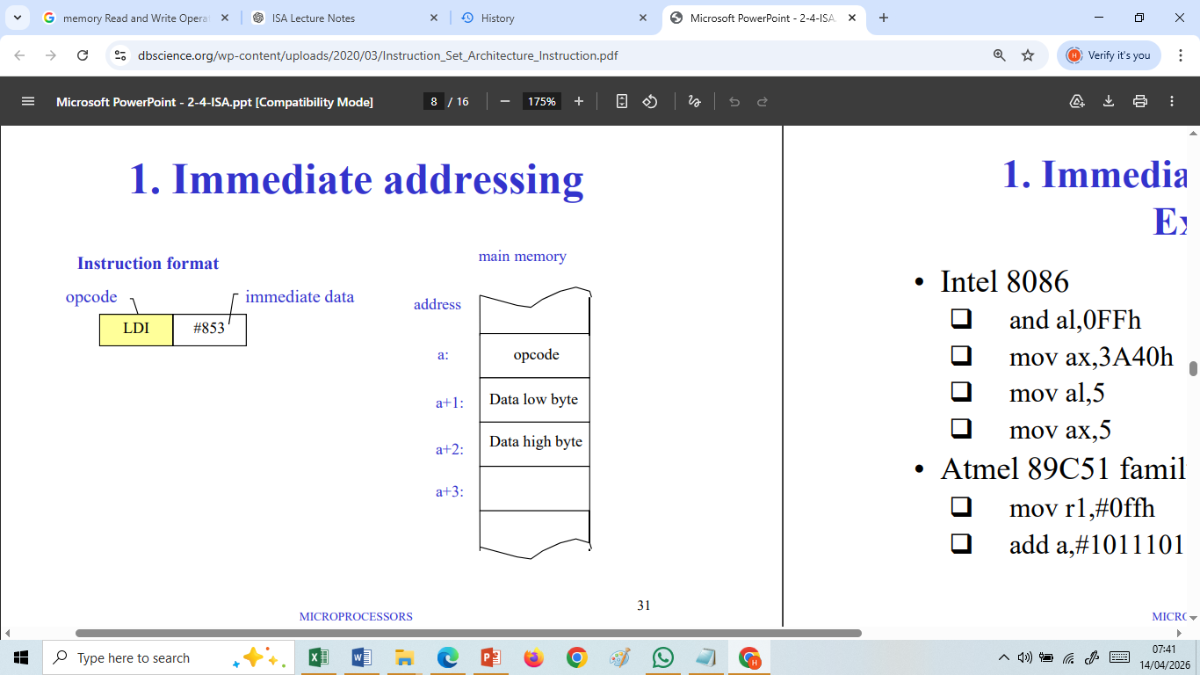
Immediate Addressing
Immediate addressing is one of the simplest and fastest addressing modes in Instruction Set Architecture (ISA).
In this mode, the actual operand (data value) is directly embedded inside the instruction itself, rather than being stored in a register or memory location.

Slide 48
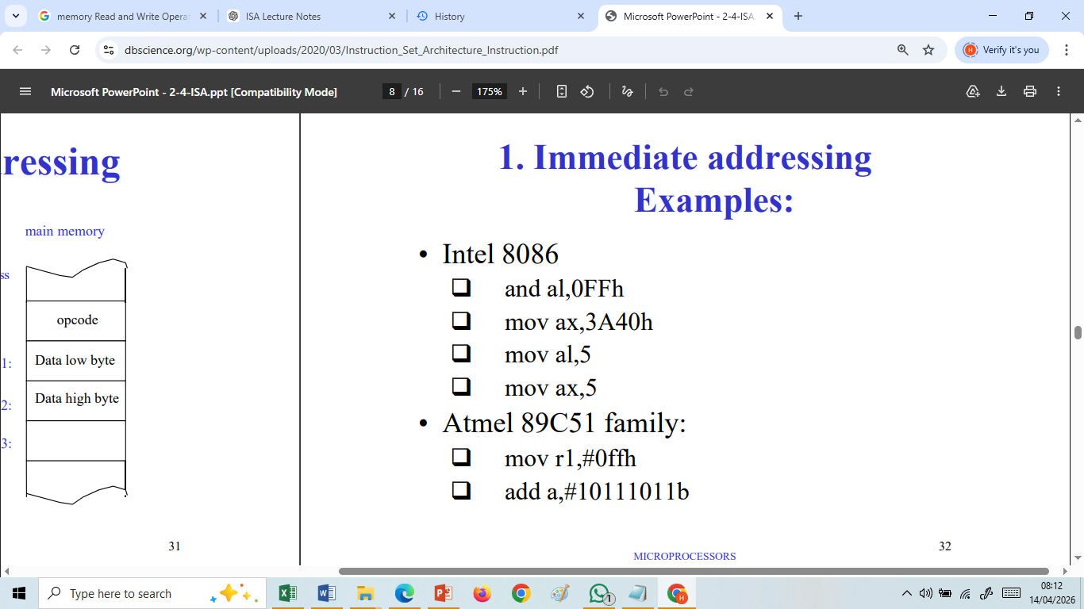
Immediate Addressing -Examples

Slide 49
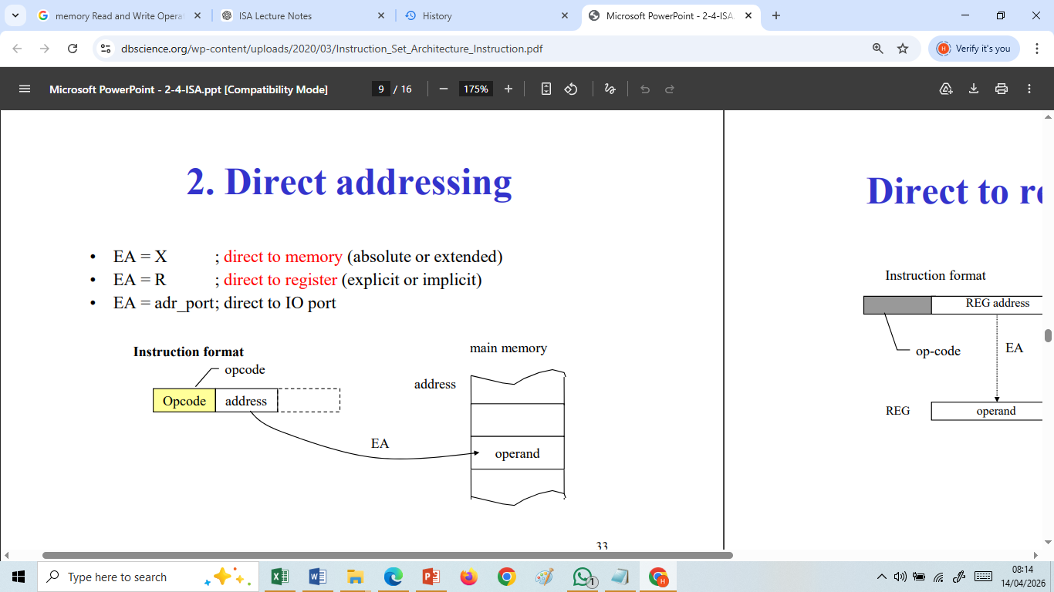
Direct Addressing Mode
An addressing technique in which the address field of the instruction contains the actual memory location of the operand.
How It Works
CPU reads the instruction
Extracts the memory address
Accesses that memory location
Retrieves or stores data

Slide 50
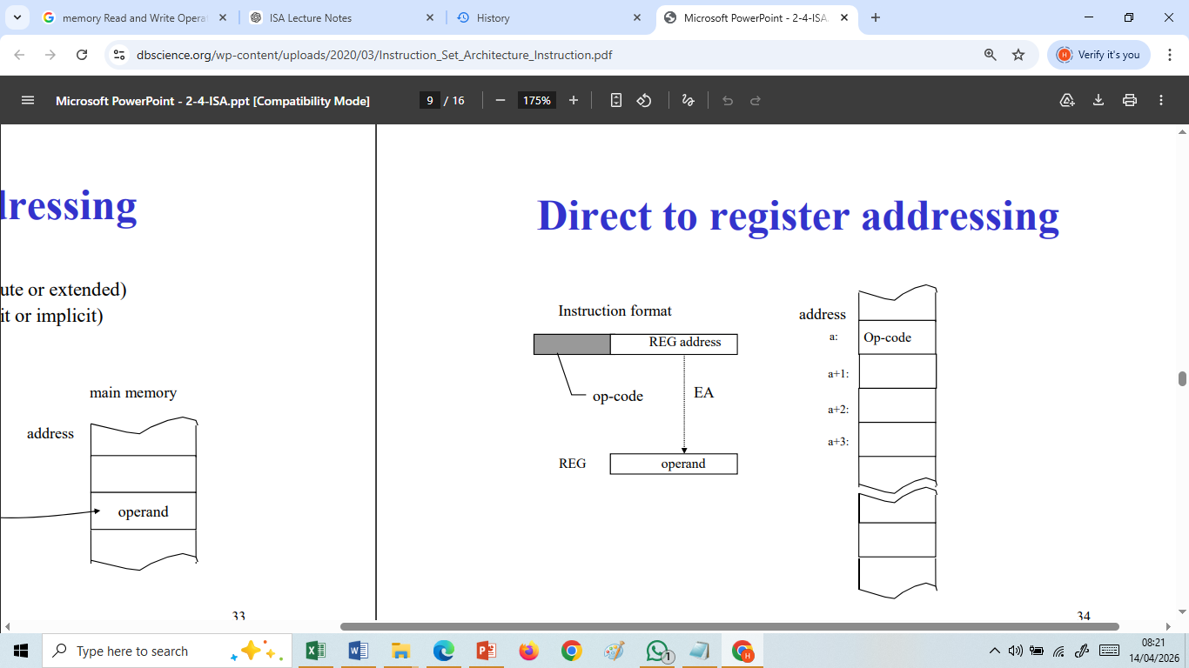
Direct Addressing Mode

Slide 51
Indirect Addressing Mode
An addressing technique in which the address field of the instruction contains the address of another memory location that stores the effective address of the operand.
Basic Format
|Opcode|Address|
Interpretation
Address field → does not contain actual operand location
It contains → pointer to the operand’s address

Slide 52
Indirect Addressing Mode
How It Works (Step-by-Step)
CPU fetches the instruction
Reads the address field (say A)
Goes to memory location A
Retrieves the effective address (EA) stored there
Accesses operand using EA
Example 1
LOAD R1, (200)
Explanation
Instruction contains 200
Memory[200] contains 500
Memory[500] contains actual data
Final operation:
R1 = Memory[500]

Slide 53
Indirect Addressing Mode
Example 2
LOAD R2,(300)
Given:
Memory[300] = 400
Memory[400] = 50
Solution:
R2 = 50
Example 3
ADD R1, (150)
Given:
R1 = 10
Memory[150] = 250
Memory[250] = 5
Solution:
R1 = 10 + 5 = 15
Example 4
STORE R3, (500)
Given:
R3 = 30
Memory[500] = 800
Solution:
Memory[800] = 30

Slide 54
Relative Addressing Mode
Relative Addressing Mode is defined as:
An addressing technique in which the effective address (EA) is obtained by adding a displacement (offset) to the current value of the Program Counter (PC).
Formula:
Effective Address (EA) = PC + Offset

Slide 55
Relative Addressing Mode
How It Works (Step-by-Step)
CPU fetches the instruction
PC already points to the next instruction
Offset is extracted from instruction
Offset is added to PC
Result gives target address (EA)

Slide 56
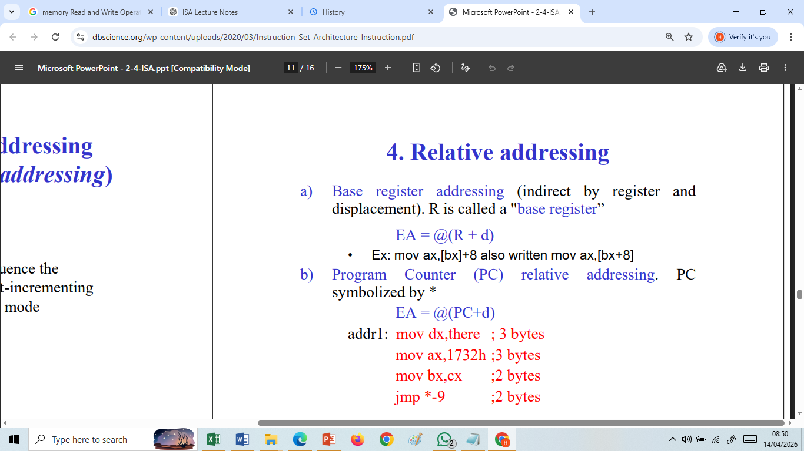
Relative Addressing Mode

Slide 57
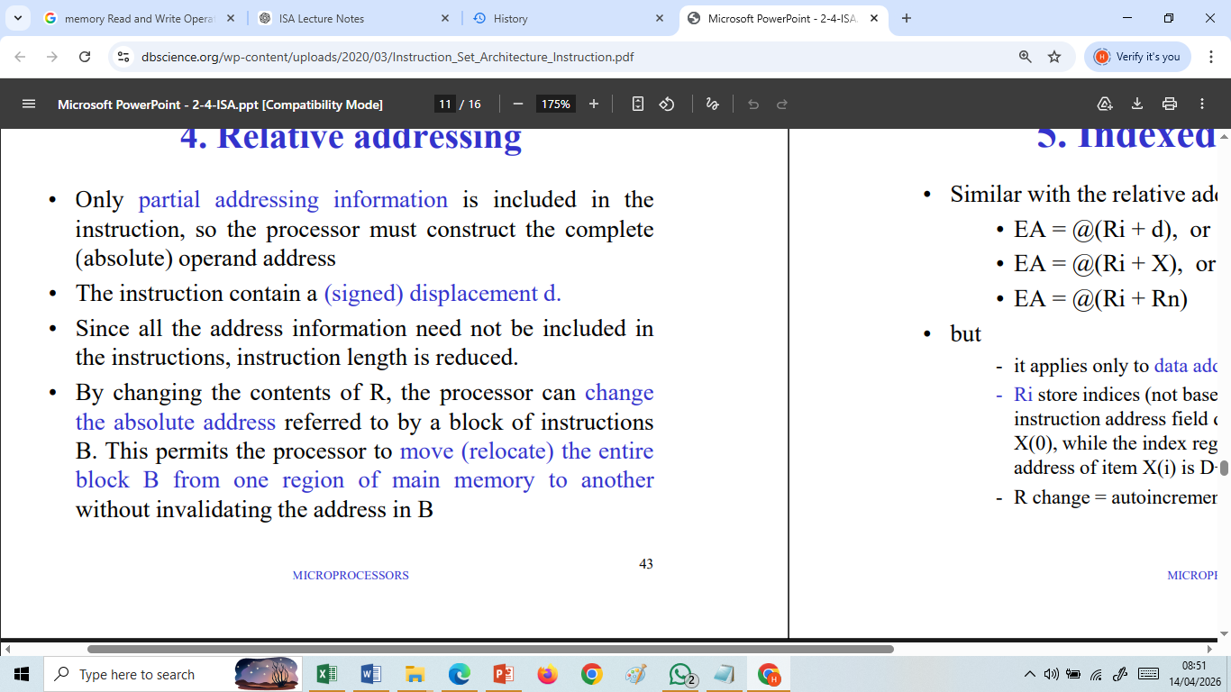
Relative Addressing Mode

Slide 58
Relative Addressing Mode
Example 1
BEQ R1, R2, +30
Given:
PC = 200
Solution:
𝐸𝐴=200+30 = 230
Jump to 230 if R1 = R2
Example 2
BNE R3, R4, -40
Given:
PC = 1000
Solution:
𝐸𝐴=1000−40=960
Jump to 960 if R3 ≠ R4

Slide 59
Indexed Addressing Mode
Assignment for Students

Slide 60
END OF UNIT

